Slide 1
Asymmetric medial rectus recession in Bilateral esotropic Duanes Retraction Syndrome
Dr Smita Kapoor
Consultant Paediatric Ophthalmology & Strabismus
Vision Eye Centres, New Delhi

Slide 2
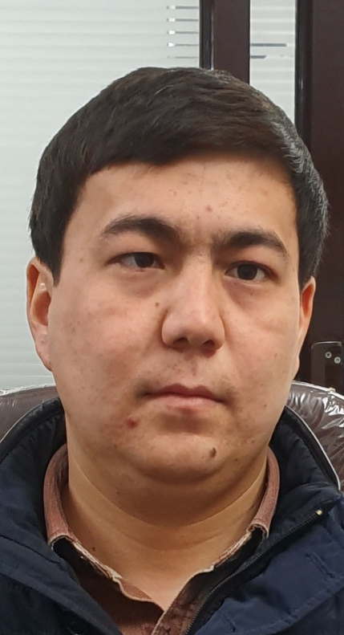
CLINICAL PRESENTATION
35 YEAR OLD MALE
HISTORY OF SQUINTING SINCE BIRTH
VISUAL ACUITY 6/6,N6 (BOTH EYES)
ANTERIOR SEGMENT NORMAL (BOTH EYES)
FUNDUS NORMAL (BOTH EYES)
PRISM COVER TEST – 35 PD ET (PRIMARY GAZE)
WFDT – BSV PRESENT (FACE TURN)
LE SUPPRESSION (STRIAGHT)
FACE TURN TO LEFT SIDE

Slide 3

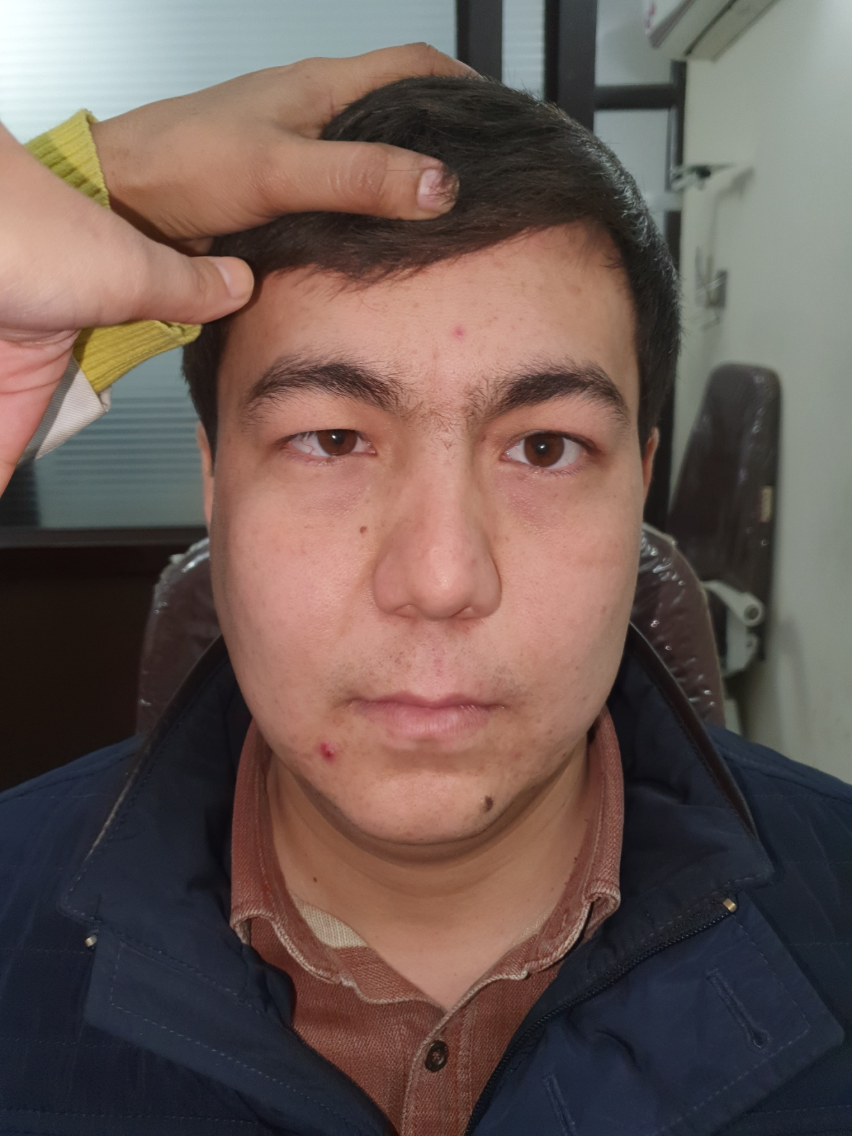
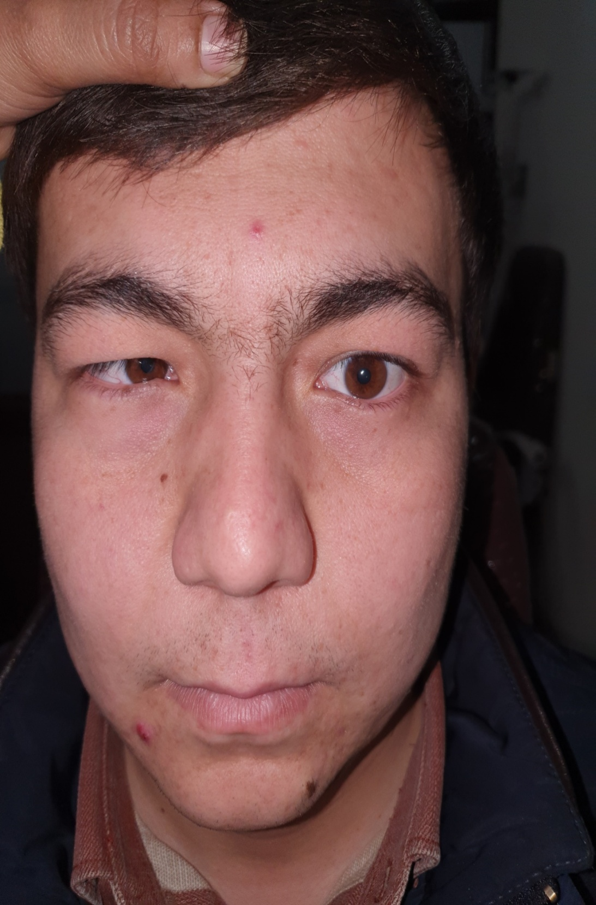
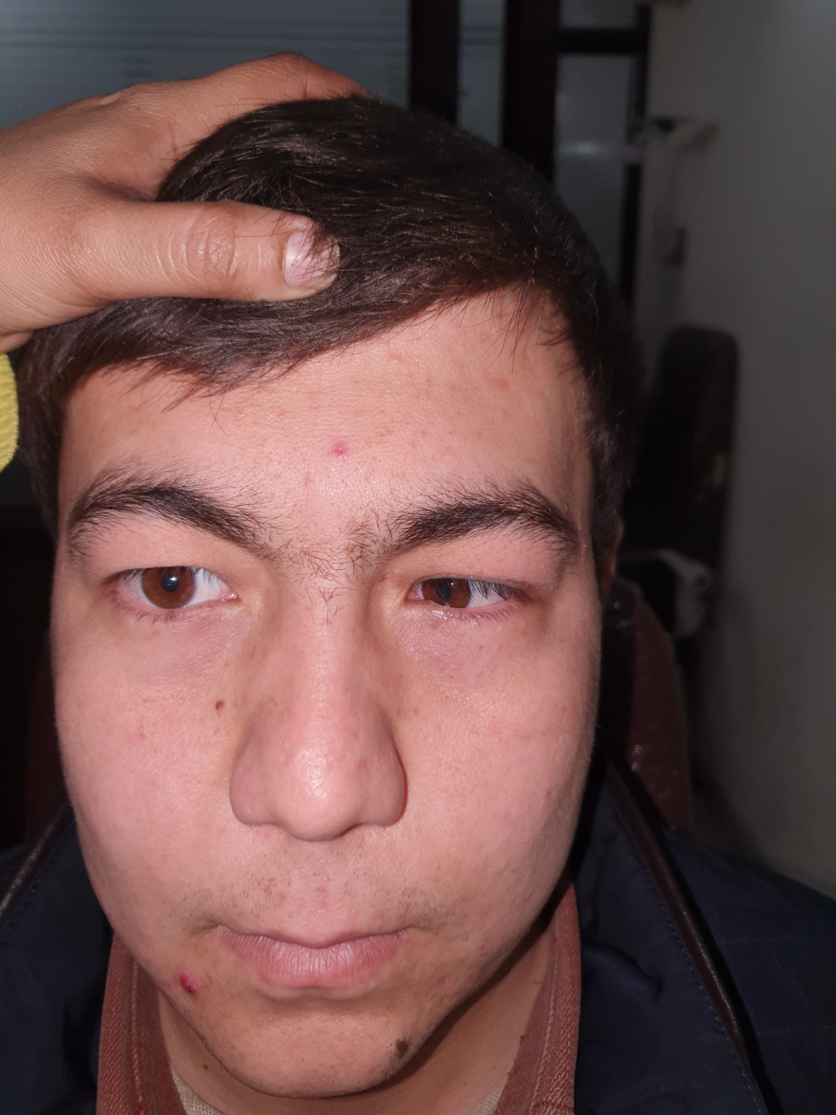
PALPEBRAL FISSURE WIDTH
RE - 11 MM | LE - 8 MM
RE (ON ADDUCTION) - 7 MM | LE (ON ADDUCTION) - 7 MM
RE (ON ABDUCTION) -13 MM | LE (ON ABDUCTION) - 13 MM

Slide 4

DIAGNOSIS- BILATERAL DUANES RETRACTION SYNDROME TYPE 1
ESOTROPIA IN PRIMARY GAZE
EQUAL PRIMARY AND SECONDARY DEVIATION
BILATERAL RESTRICTED ABDUCTION
BILATERAL MILDLY DEFECTIVE ADDUCTION
GLOBE RETRACTION ON ADDUCTION

Slide 5
SURGICAL PROCEDURE
INTRAOPERATIVE FDT POSITIVE FOR MEDIAL RECTUS (L>R)
RE MEDIAL RECTUS RECESSION – 4.0 MM
LE MEDIAL RECTUS RECESSION – 6.0 MM
REPEAT FDT NEGATIVE FOR MEDIAL RECTUS AFTER RECESSION

Slide 6


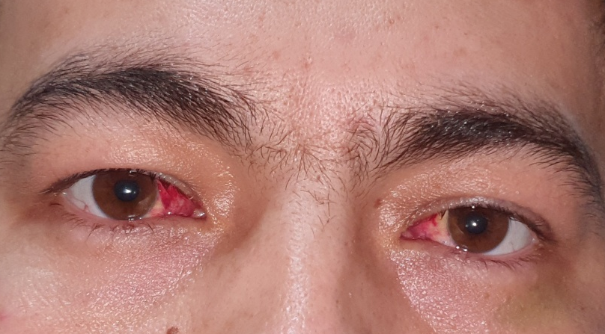
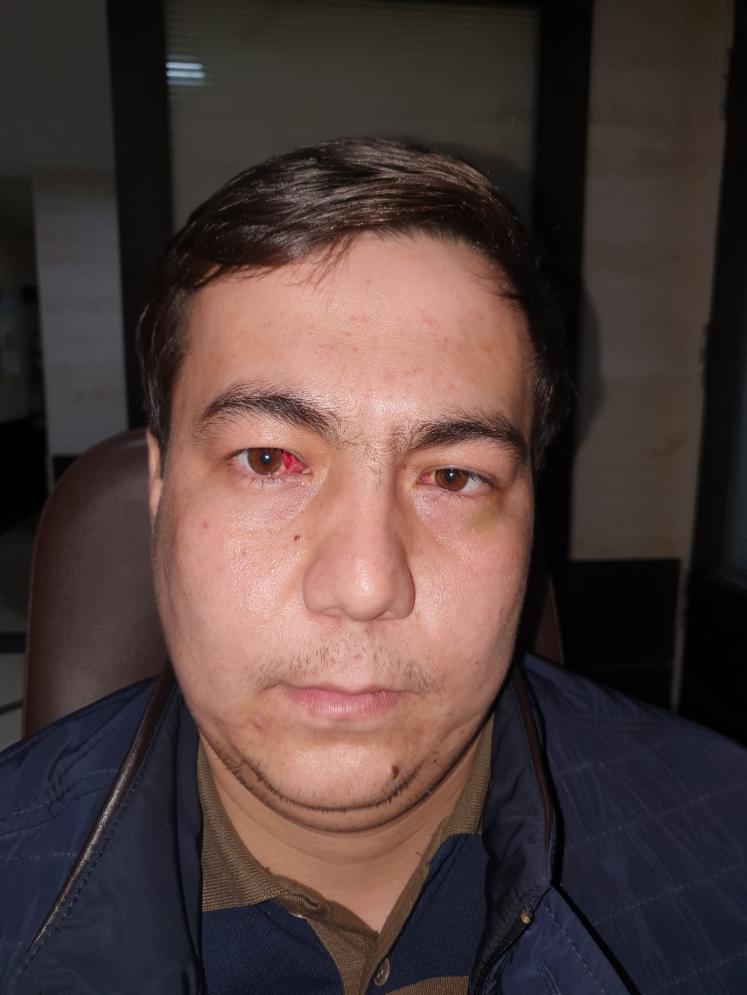
RESULTS - POSTOPERATIVE PHOTOGRAPHS
IMPROVEMENT IN HEAD POSTURE
ORTHOTROPIA
IMROVEMENT IN PALPEBRAL FISSURE WIDTH

Slide 7
DISCUSSION
Incidence of bilateral DRS – 10% to 24%
In bilateral DRS most common presentation is Type 1
The surgical techniques used in eso DRS –
VRT or SRT ≤ 12-14 PD
Unilateral MR recession ≤ 20 PD
Bilateral MR recession > 20 PD
MR recession + LR resection in the absence of globe retraction
Combined MR recession + VRT to improve abduction
Forced Duction Tests play an important role in DRS
Amount of medial rectus recession can be adjusted intraoperatively depending on FDT

Slide 8
REFERENCES
Kekunnaya R, Negalur M. Duane retraction syndrome: causes, effects and management strategies. Clin Ophthalmol. 2017;11:1917-1930.
Duane A. Congenital deficiency of abduction associated with impairment of adduction, retraction movements, contraction of the palpebral fissure and oblique movements of the eye. Arch Ophthalmol. 1996;114(10):1255–1256.
DeRespinis P, Caputo A, Wagner R, Guo S. Duane’s retraction syndrome. Surv Ophthalmol. 1993;38(3):257–288.
Turk S. Bemerkungen zu einem Falle von Retraction des Auges. Cbl Pract Augenheilk. 1899;23:14.
Zauberman H, Magora A, Chaco J. An electromyographic evaluation of the retraction syndrome. Am J Ophthalmol. 1967;64(6):1103–1108.
Gurwoods AS, Terrigno CA. Duane’s retraction syndrome: literature review. Optometry. 2000;71(11):722–776.

Slide 9
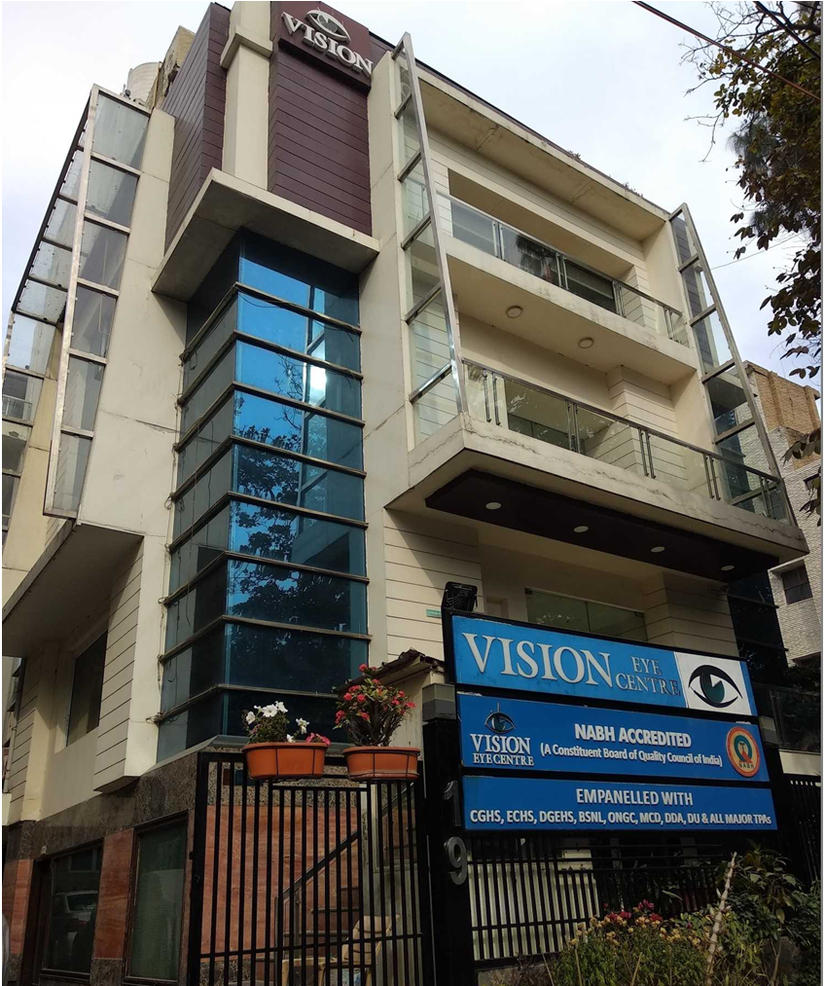
THANK YOU

